Slide 1
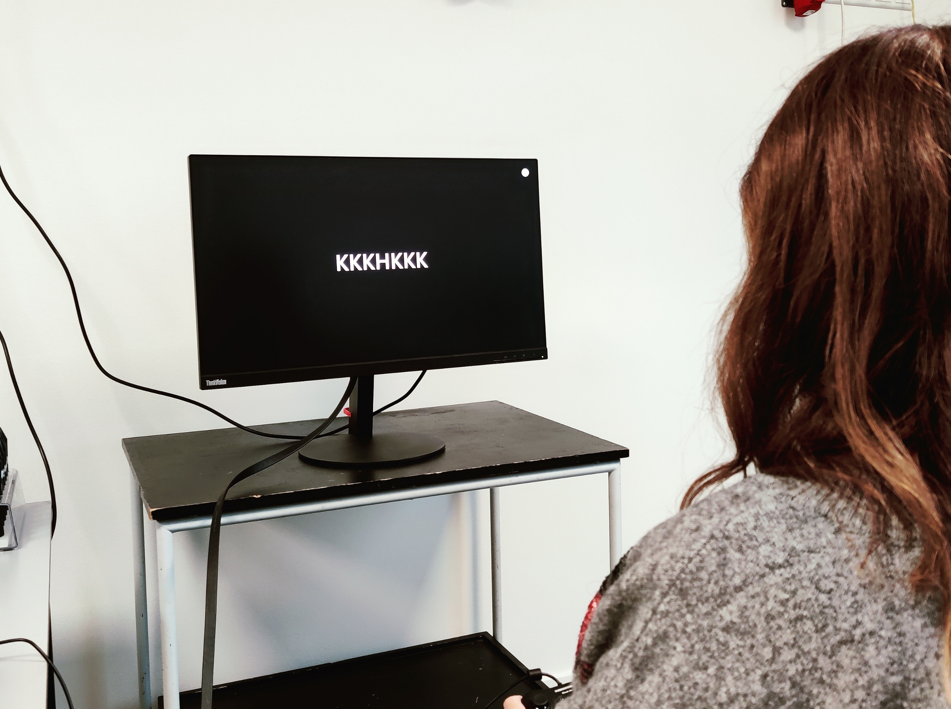

Protocol Name
Authors
The Flanker Task is a cognitive test used to assess attention and inhibitory control. In this task, participants must focus on a target stimulus (usually an arrow or letter) presented at the centre of a visual array and respond based on its direction or identity. The target is flanked by distracting stimuli (flankers) that can be congruent (pointing in the same direction or matching the target) or incongruent (pointing in a different direction or mismatching).
Notes:
How to shape the figure.
Place the photo below the blue shape.
Select the photo then the blue shape.
Then choose to merge shapes by Intersect

